Slide 1
SuperKart Sales Forecasting & Model Deployment
Predicting Product-Store Sales with Machine Learning | Model Deployment
June 2026

Slide 2
Contents / Agenda
Executive Summary
Business Problem Overview and Solution Approach
EDA Results
Data Preprocessing
Model Building
Model Performance Summary
Deployment
Recommendation – Adding Product Price (MRP)

Slide 3
Executive Summary
A machine-learning model was built to forecast product-level sales for each store, using historical data on 8,763 product-store records across 4 outlets.
Random Forest and XGBoost (with and without tuning) were compared; all four are statistically tied at Test R² ≈ 0.668 (RMSE ≈ ₹616, MAPE ≈ 18.7%), with a slight, consistent edge to Random Forest.
Tuned Random Forest was selected and deployed as the production model.
Product MRP (price) is the strongest correlate of sales (r = 0.79); a controlled test shows adding it would lift Test R² from 0.67 to 0.93 — a recommended future enhancement (see Recommendation slide).
Store format drives revenue: Departmental Stores and Tier-1 cities generate ~3x the sales of Food Marts and Tier-3 locations; OUT004 alone produced ₹15.4M — more than the other three outlets combined.
Recommendation: operate the tuned Random Forest forecasting service (Flask API + Streamlit app) to guide inventory, supply-chain planning, and store strategy.

Slide 4
Business Problem Overview and Solution Approach
Business problem
SuperKart needs accurate sales forecasts at the product-store level to plan inventory, optimize the supply chain, and benchmark store performance.
The target, Product_Store_Sales_Total, is continuous — this is a regression problem.
Solution approach / methodology
Exploratory data analysis to understand sales drivers and data quality.
Feature engineering + a preprocessing pipeline (one-hot encoding of categoricals).
Train and compare 6 tree-based / ensemble regressors on R², RMSE, MAE, MAPE.
Hyperparameter-tune the strongest candidates, select the best, and deploy it as an API + web app.

Slide 5
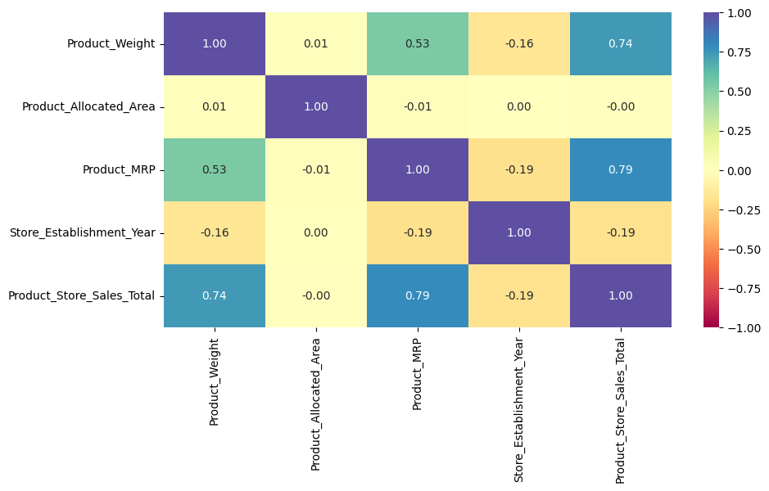
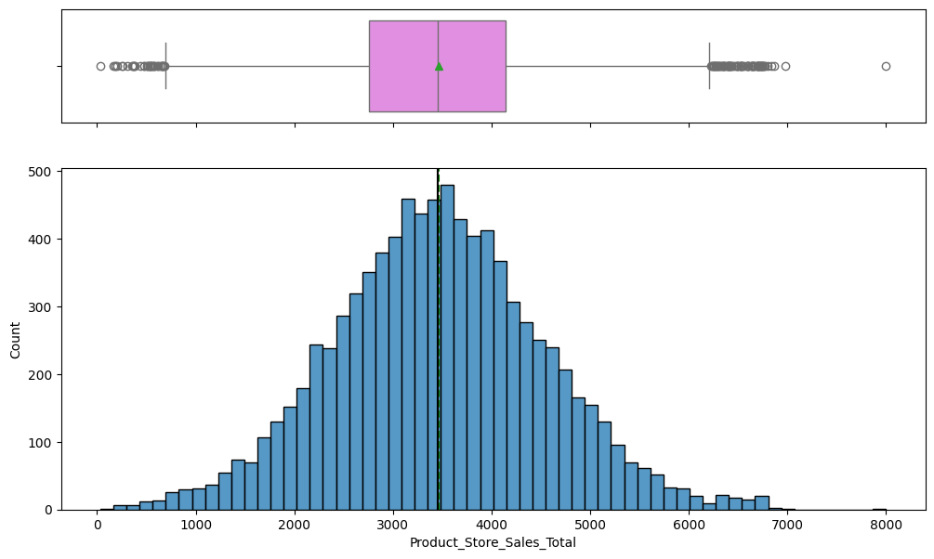
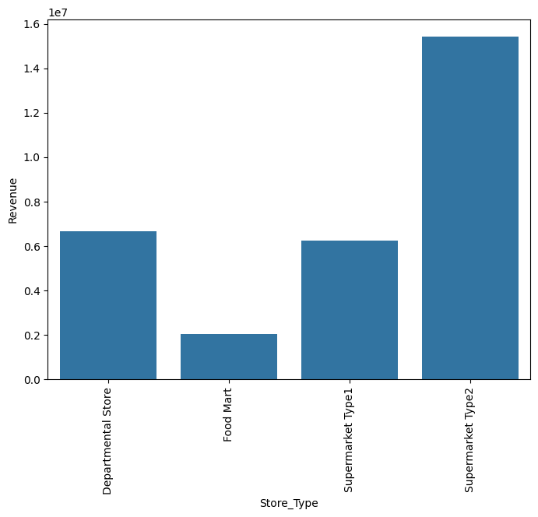
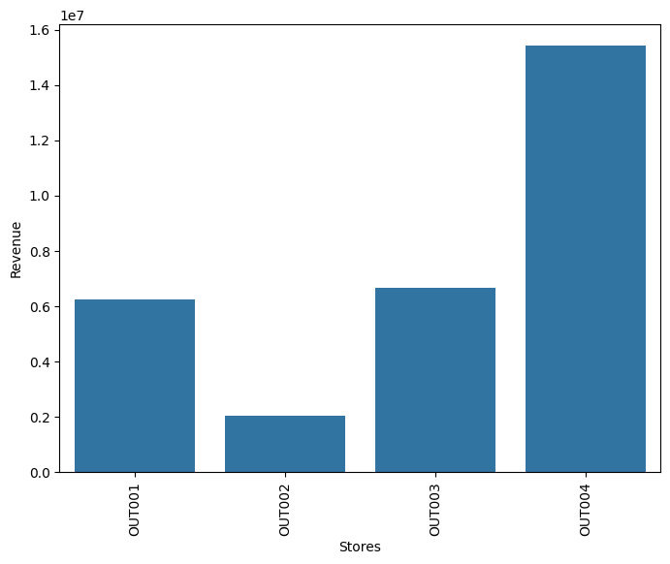
EDA Results
Target sale averages ₹3,464, roughly symmetric.
Top drivers: Product_MRP (0.79) and Product_Weight (0.74); Allocated_Area ≈ 0.
Store format: Departmental > Type1 > Type2 > Food Mart; Tier-1 and High-size lead.
Revenue: OUT004 ≫ OUT003 > OUT001 > OUT002.
Link to Appendix slide on data background check

Slide 6
Data Preprocessing
Feature engineering
Store_Age_Years = 2025 − Store_Establishment_Year.
Product_Id_char = first two characters of Product_Id (FD / DR / NC categories).
Grouped 16 product types into two categories: Perishables vs Non-Perishables.
Data cleaning
Standardized inconsistent label: 'reg' → 'Regular' in Product_Sugar_Content.
No missing values and no duplicate rows in the dataset.
Data preparation for modeling
Dropped identifiers/redundant columns: Product_Id, Product_Type, Store_Id, Store_Establishment_Year.
Pipeline: OneHotEncoder(handle_unknown='ignore') on the categorical features; numeric columns are dropped (deployed model is categorical-only), fused with each model.
70/30 train-test split (6,134 train / 2,629 test), random_state = 1.

Slide 7
Data Background and Contents
Dataset: 8,763 rows × 12 columns; no missing values, no duplicates.
Product attributes: Product_Weight, Product_Sugar_Content, Product_Allocated_Area, Product_Type, Product_MRP.
Store attributes: Store_Establishment_Year, Store_Size, Store_Location_City_Type, Store_Type.
Identifiers: Product_Id, Store_Id (4 outlets: OUT001–OUT004).
Target variable: Product_Store_Sales_Total (total sales of a product at a store).
Coverage: 16 product types across 4 stores spanning 3 city tiers and 3 store sizes.

Slide 8
Model Building
Built Random Forest and XGBoost regressors inside one preprocessing pipeline (one-hot encoded store/product categoricals); evaluated on the held-out test set.
Both base models perform almost identically — Test R² ≈ 0.668, RMSE ≈ ₹616, MAPE ≈ 18.7% — a statistical tie, with Random Forest holding a slight, consistent edge.
R² and RMSE are two views of the same errors (R² = 1 − RMSE²/Var(y)), so they rank the models the same; MAPE ≈ 18.7% agrees, confirming the tie.
The models explain ~67% of sales variance, giving a solid baseline for demand planning.
Model (base) | Test R² | RMSE (₹) | MAE (₹) | MAPE
Random Forest | 0.668 | 616 | 485 | 18.7%
XGBoost | 0.668 | 616 | 485 | 18.7%

Slide 9
Model Improvement - Hyperparameter Tuning
Tuned both finalists with GridSearchCV (cv = 3, scoring = R²).
Random Forest — best params: max_features = 'sqrt', n_estimators = 100, max_depth = None (the grid landed on the defaults).
Test R² unchanged at 0.668; tuned Random Forest is identical to the base model.
XGBoost — best params: gamma = 0, n_estimators = 100 (near-defaults).
Test R² unchanged at 0.668 (RMSE ₹616) — no meaningful gain.
Takeaway: tuning produced no measurable improvement — the models are already at the performance ceiling set by the available (categorical-only) features. Random Forest and XGBoost remain tied, and tuned Random Forest is taken forward as the selected model.

Slide 10
Model Performance Summary
Final selected model: Tuned Random Forest (serialized with joblib and deployed).
All four models are statistically tied — Test R² ≈ 0.668, differing only at the 4th decimal — but Random Forest holds a slight, consistent edge over XGBoost across every metric.
Random Forest (tuned) was selected for deployment; the price-inclusive analysis (next slide) reinforces Random Forest as the stronger model family.
Selected-model test performance: R² = 0.668, RMSE = ₹616, MAE = ₹485, MAPE = 18.7%.
Model | Test R² | Adj R² | RMSE (₹) | MAE (₹) | MAPE
Random Forest (tuned) ★ deployed | 0.668 | 0.667 | 616 | 485 | 18.7%
Random Forest (base) | 0.668 | 0.667 | 616 | 485 | 18.7%
XGBoost (base) | 0.668 | 0.667 | 616 | 485 | 18.7%
XGBoost (tuned) | 0.668 | 0.667 | 616 | 486 | 18.7%

Slide 11
Deployment
Tuned Random Forest serialized with joblib and served via a Flask REST API.
Endpoint POST /v1/predict accepts product + store attributes and returns predicted sales as JSON.
Streamlit web app provides a UI for single predictions and batch (CSV) scoring.
Both the backend API and frontend are containerized with Docker and hosted on Hugging Face Spaces.
Backend API: https://araujohn-rkt-superkart-backend.hf.space (POST /v1/predict)
Frontend Streamlit app: https://araujohn-rkt-superkart-app.hf.space

Slide 12
Recommendation: Adding Product Price (MRP)
Product_MRP (price) is the single strongest predictor of sales in EDA (correlation 0.79), yet the current production model excludes it per project scope.
A controlled experiment adding Product_MRP improves every metric dramatically — and confirms Random Forest as the best model, widening its edge over XGBoost.
Business impact: typical forecast error roughly halves (RMSE ₹616 → ₹291), enabling materially tighter inventory and supply-chain planning.
Recommendation: incorporate Product_MRP (and Product_Weight) in the next model iteration once approved for use.
Feature set | Best model | Test R² | RMSE (₹) | MAPE
Without price (current) | Random Forest (tuned) | 0.668 | 616 | 18.7%
With price (proposed) | Random Forest (tuned) | 0.926 | 291 | 5.2%

Slide 13
Key Takeaways & Business Recommendations
Pricing & store format are the biggest sales levers in the data: Product_MRP correlates 0.79 with sales, and Departmental/Tier-1 stores sell ~3x Food Marts/Tier-3.
Replicate winners: study OUT004 and Departmental/Tier-1 formats to lift underperforming outlets (OUT002, Food Marts, Tier-3).
Model selection: Random Forest and XGBoost are statistically tied (Test R² ≈ 0.668), with a slight edge to Random Forest; tuned Random Forest was deployed.
Highest-impact next step: add Product_MRP (price) to the model — a controlled test lifts Test R² from 0.67 to 0.93 and cuts typical error roughly in half (see Recommendation slide).
Production-ready service (Flask API + Streamlit on Hugging Face); retrain periodically as new sales data arrives.

